Slide 1


USE
CASE DIAGRAMS

Slide 2
_A FULL EXAMPLE
UML Use Case Diagram Tutorial
https://www.youtube.com/watch?v=zid-MVo7M-E

Slide 3

01_WHAT IS USE CASE ?WHY DO WE NEED IT?
YOU HAVE AN IDEA FOR AN APPLICATION BUT YOU DON’T KNOW HOW TO EXPLAIN IT TO A PARTNER.

Slide 4
02_USE CASE ELEMENTS
SYSTEM
ACTORS
USE CASES
RELATIONSHIPS

Slide 5
03_SYSTEM:
WEBSITE
APPLICATIONS
SOFWTARE COMPONENT

Slide 6
04_ACTORS
PERSON
ORGANIZATION
SYSTEM
WEBSITE
APPLICATIONS
SOFWTARE COMPONENT

Slide 7
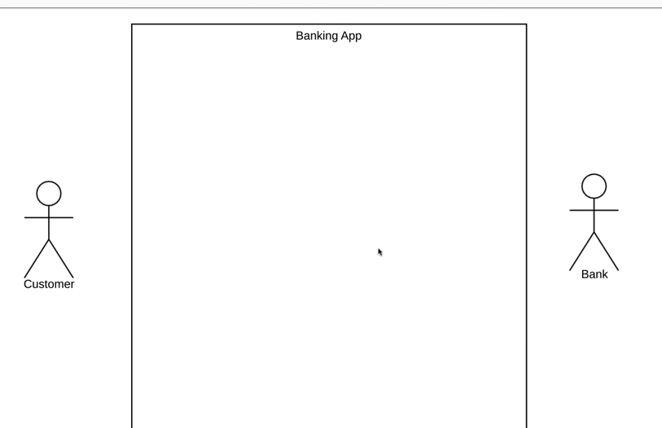
04_ACTORS
PRIMARY ACTORS: INITIATES THE USE OF THE SYSTEM. CUSTOMER, LEFT SIDE OF THE DIAGRAM
SECONDARY ACTOR: WILL ACT ONLY WHEN THE PRIMARY ACTOR DOES SOMETHING, BANK, RIGHT SIDE OF THE DIAGRAM.

Slide 8
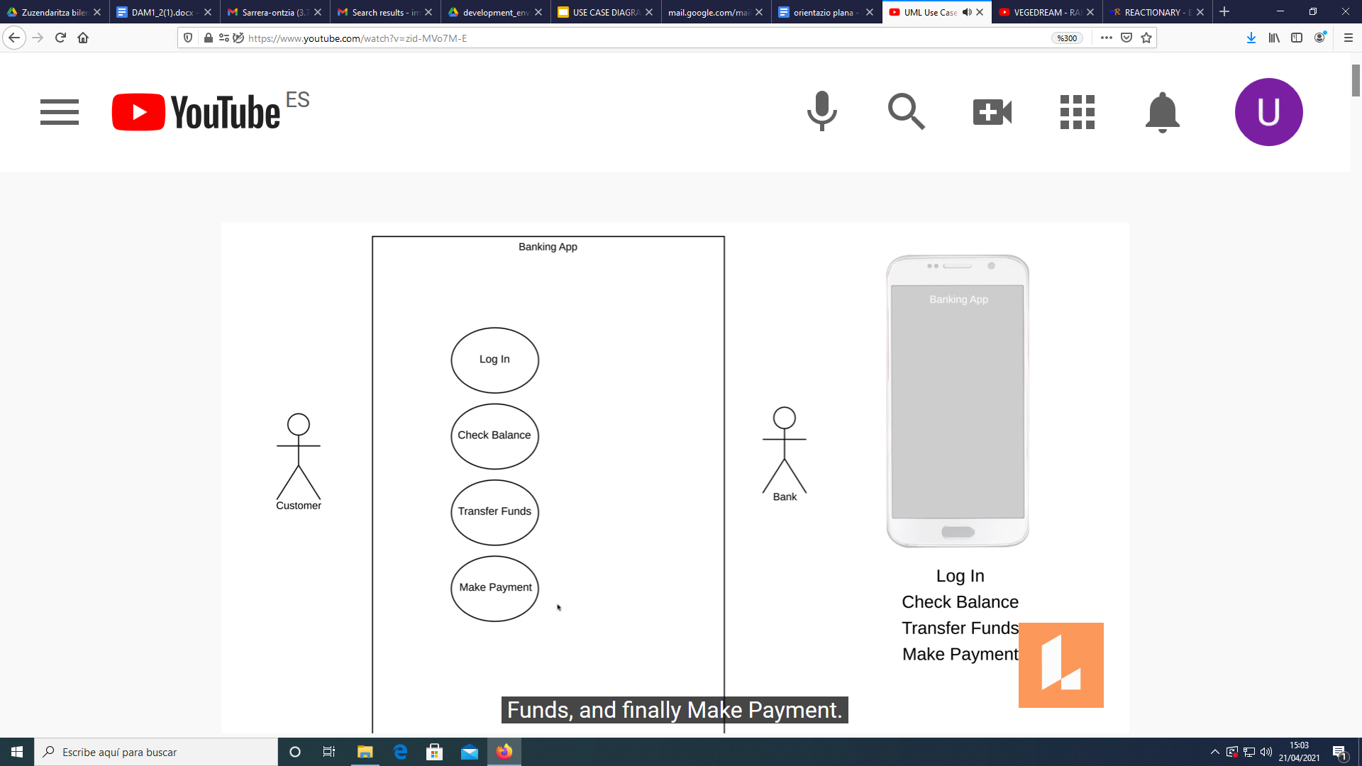
05_USE CASE
REPRESENTS FUNCTIONALITY

Slide 9
05_USE CASE
FOLLOW LOGICAL ORDER WHEN REPRESENTING THE FUNCTIONALITY

Slide 10
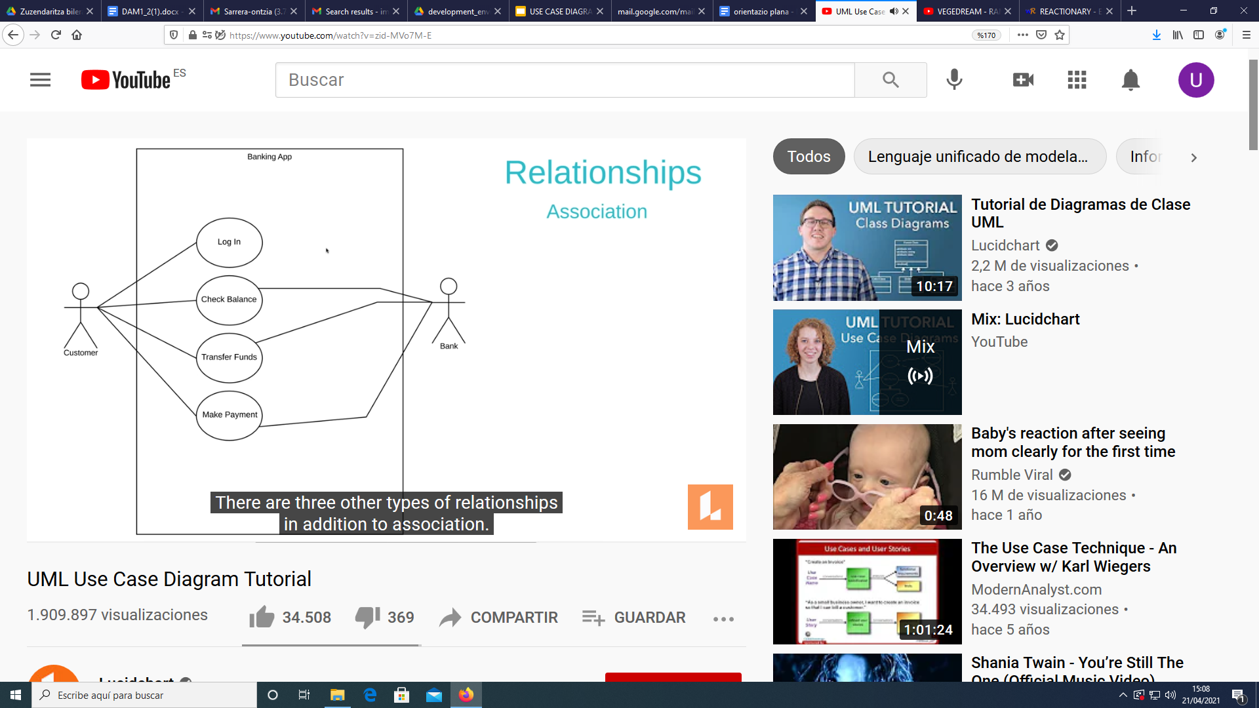
06_RELATIONSHIPS
INTERACTIONS BETWEEN ACTORS AND USE CASES

Slide 11
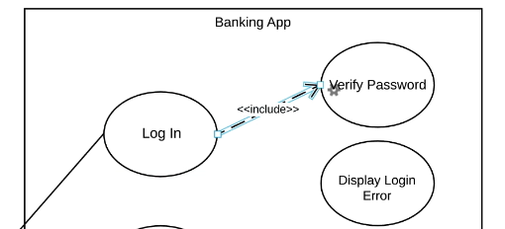
06_RELATIONSHIPS
INCLUDE: THE BASE USE CASE REQUIRES THE INCLUDED USE CASE.
EXAMPLE:LOGIN IS THE BASE USE AND , PASSWORD VERIFY IS THE INCLUDED USE CASE

Slide 12
06_RELATIONSHIPS
LOGIN USE CASE WILL BE COMPLETED WHEN THE PASSWORD VERIFICATION IS COMPLETED

Slide 13
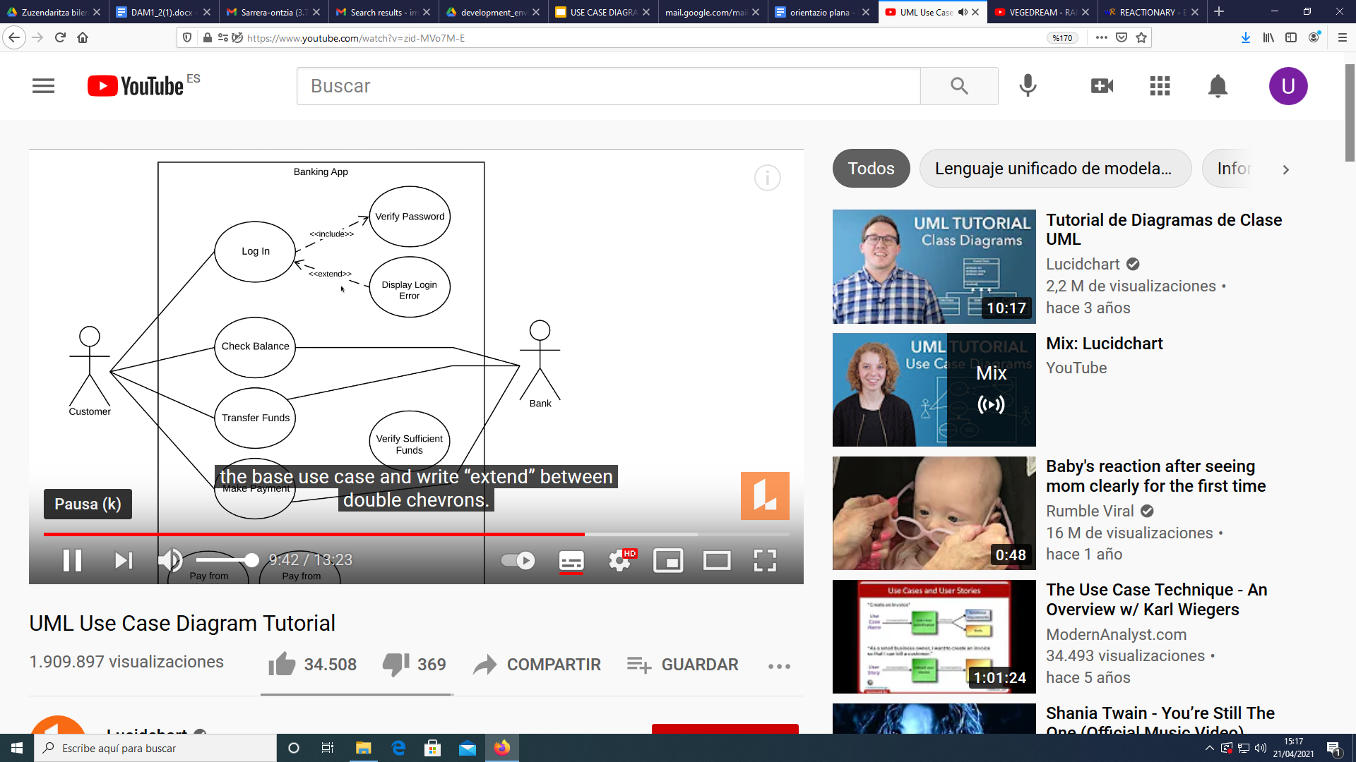
06_RELATIONSHIPS
EXTEND: THE EXTENDED USE CASE WILL BE EXECUTED ONLY SOMETIMES.
EXAMPLE:LOGIN IS THE BASE USE AND , DISPLAY LOGIN ERROR IS THE EXTENDED USE CASE

Slide 14
06_RELATIONSHIPS
EXTEND: ONLY HAPPENS SOMETIMES

